Slide 1
CSE4501: Operating Systems Lecture 0
Mohammad Ridwan Kabir (MRK)
Assistant Professor
Dept. of CSE, IUT

Slide 2
Reference Book
▪ Silberschatz, Galvin, and Gagne, Operating System Principles, 7th ed., Wiley, 2006
▪ A. Tanenbaum, Operating Systems: Design and Implementation, 2nd ed., Prentice-Hall, 2001

Slide 3
Course Outline
Operating Systems Overview and Introduction
Processes
Threads
CPU Scheduling
Process Synchronization
Deadlock
Memory Management
Virtual Memory

Slide 4
What is an Operating System?
A program that acts as an intermediary between a user of a computer and the computer hardware.
Operating system goals:
Execute user programs and make solving user problems easier.
Make the computer system convenient to use.
Use the computer hardware in an efficient manner.

Slide 5
To understand what OS are, we must first understand how they have developed.

Slide 6
History of OS
Single user single process
One User, One Task at a time
Batch Systems
Same type of processes batched together
Multi-Programmed Batched Systems
Batched processes distributed among processors
Time Sharing Systems
Shares Processor time

Slide 7
History of OS
Personal-Computer Systems
PC
Parallel Systems
Multiple processors solve parts of a problem in parallel to give a combined output
Distributed Systems
Multiple processors handle multiple applications and/or users
Processors communicate via different communication lines.
Real-Time Systems
Responds to inputs as they arrive
Reduces the response time

Slide 8
Computer-system architecture
Single-processor systems :
Multiprocessor systems: (Parallel system or tightly coupled system) : two types
Asymmetric multiprocessing
Symmetric multiprocessing(SMP)
Have three main advantages :-
Increased throughput
Economy of scale
Increased reliability

Slide 9
Computer-system architecture
Features | Asymmetric Multiprocessing | Symmetric Multiprocessing
CPUs | Multiple | Multiple
Architecture | Same or Different | Same
Address Space | Each CPU has own address space | CPU Share Memory Space
OS | Each CPU may or may not run an OS and the OS need not be same | Only one OS runs on all CPUs
Communication | Present | Present and it is normally shared memory

Slide 10
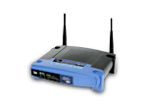
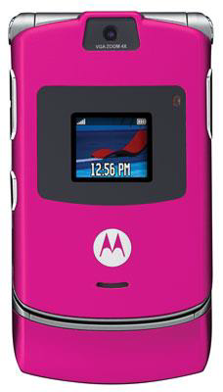
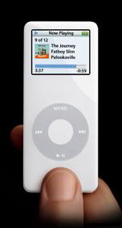
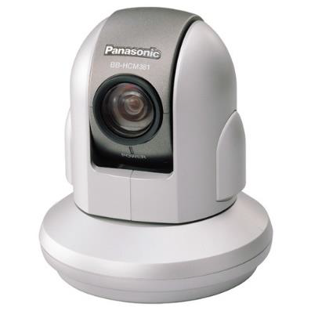
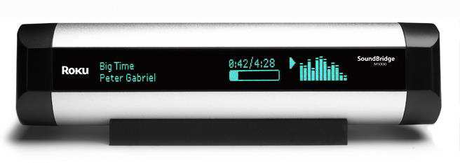
Computing Environment
Client-Server Systems
Mail server/service
File server/service
Compute-server system
Peer-to-Peer (P2P) Systems:
P2P computing or networking is a distributed application architecture that partitions tasks or work loads between peers. Peers are equally privileged, equipotent participants in the application.
Napster, Gnutella etc.
Web-based computing
Embedded and Mobile Systems

Slide 11
Primary functions of an os
Processes-process management
Storage-memory management
Data-file management
Input/output devices-i/o management

Slide 12
Secondary functions of an os
User Accounting
Logging
Utility software-calculator, calendar, find, clock, help etc.

Slide 13
THANK YOU

